Slide 1
Function Notation

Slide 2
Function form of an equation
Function Notation is a way to name a function. It is pronounced “f of x”
f(x) is a fancy way of writing “y” in an equation.

Slide 3
Evaluating Functions
If you are given a value of x and looking for f(x) or the y – value.

Slide 4
1. Evaluating a function
Tell me what you get when x is -2.
f(x) = 2x – 3 when x = -2
f(-2) = 2(-2) – 3
f(-2) = - 4 – 3
f(-2) = - 7

Slide 5
2. Evaluating a function
Tell me what you get when x is 3.
f(x) = 32(2)^{x} when x = 3
f(3) = 32(2)³
f(3) = 256

Slide 6
3. Evaluating a function
Tell me what you get when x is -3.
f(x) = x² – 2x + 3 find f(-3)
f(-3) = (-3)² – 2(-3) + 3
f(-3) = 9 + 6 + 3
f(-3) = 18

Slide 7
4. Evaluating a function
Tell me what you get when x is 3.
f(x) = 3x + 1 find f(3)
f(3) = 3(3) + 1
f(3) = 10

Slide 8
Evaluating Functions
If you are given f(x) or the y – value and looking for x.

Slide 9
1. Evaluating a function
f(x) = 6x + 4 Find x if f(x)= 16.
16 = 6x + 4
12 = 6x
2 = x so x = 2

Slide 10
2. Evaluating a function
f(x) = 7 – x Find x if f(x) = – 5.
– 5 = 7 – x
– 12 = – x
12 = x so x = 12

Slide 11
Evaluating Functions
If you are given the graph of a function and looking for a particular x – value or y – value.

Slide 12
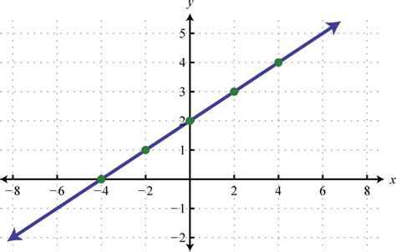
Evaluating a function
Find f(0) = _______ Find f(_____) = 1
Find f(2) = _______ Find f(_____) = 0

Slide 13
Domain and Range
Only list repeats once
Put in order from least to greatest

Slide 14
1. What are the Domain and Range?
Domain:
Range:
{1, 2, 3, 4, 5, 6}
{1, 3, 6, 10, 15, 21}

Slide 15
2. What are the Domain and Range?
Domain:
Range:
{0, 1, 2, 3, 4}
{1, 2, 4, 8, 16}

Slide 16
3. What are the Domain and Range?
Domain:
Range:
All Reals
All Reals

