Slide 1
Function or Relation?

Slide 2
What is a Relation?
Any set of input that has an output.

Slide 3
What is a Function?
A relation such that every single input has exactly ONE output
Each element from the domain is paired with one and only one element from the range

Slide 4
How do I know if a relation is a function?
Look at the input and output table – Each input must have exactly one output.
Look at the graph and use the Vertical Line Test: NO vertical line can pass through two or more points on the graph.

Slide 5
Look at the set of ordered pairs: the x–values cannot repeat unless the exact same point is listed more than once.

Slide 6
Domain
x – coordinates
Independent variable
Input

Slide 7
Range
y – coordinates
Dependent variable
Output

Slide 8
Function or relation?
Example 1:
{(3, 2), (4, 3), (5, 4), (6, 5)}
function

Slide 9
Function or relation?
Example 2:
function

Slide 10
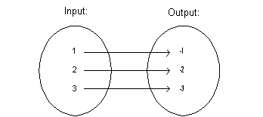
Function or relation?
Example 3:
relation

Slide 11
Function or relation?
Example 4:
( x, y) = (student’s name, shirt color)
function

Slide 12
Function or relation?
Example 5: Red Graph
relation

Slide 13
Function or relation?
Example 6:
Jacob
Angela
Nick
Greg
Tayla
Trevor
Honda
Toyota
Ford
function

Slide 14
Function or relation?
Example 7:
{(4, – 5), (1, 3), (0, 7), (6, 9), (1, – 3)}
relation

Slide 15
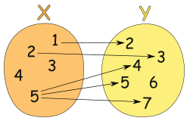
Function or relation?
Example 8:
relation

Slide 16
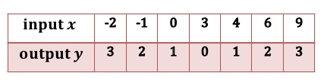
Function or relation?
Example 9:
function

Slide 17
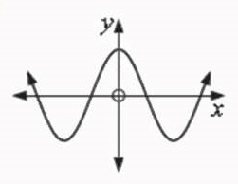
Function or relation?
Example 10:
function

Slide 18
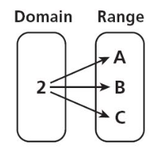
Function or relation?
Example 11:
relation

Slide 19
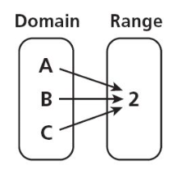
Function or relation?
Example 12:
function

